Slide 1
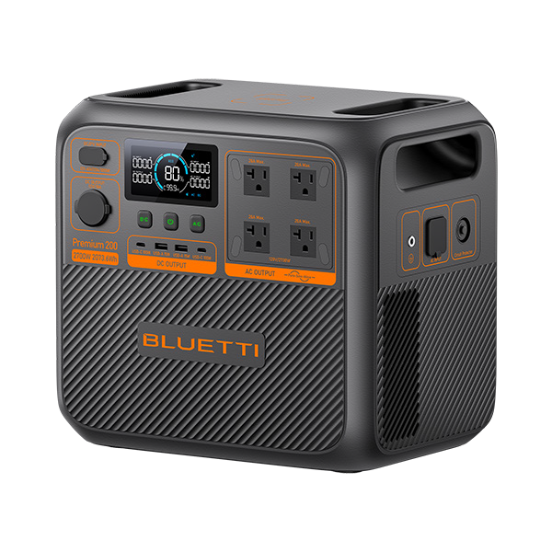
BLUETTI Premium 200 V2
Specification
General
Bi-directional Inverter (No Adapter Required)
√
1 2 3 4
5
6 7 8
Bypass Charging
√
1 ^{DC Power Button}
7 ^{AC Input}
MPPT
√
12
2 ^{LCD Display}
8 Circuit Breaker
11
10
9
12.74in / (323.6mm)
UPS
15ms
3 ^{Power Button}
9 ^{USB-A Ports}
4 ^{AC Power Button}
10 ^{USB-C Ports}
App Control
WiFi & Bluetooth
5 ^{AC Outlet}
₁₁ Cigarette Lighter Port
Accessory
Charger 1 Alternator Charger
(Car Outlet)
13.78in / (350mm)
9.84in / (250mm)
6 ^{Grounding Terminal*}
12 ^{DC input}
Noise Level
16dB - 50dB
Charging Temperature
32°F - 104°F (0°C - 40°C)
Battery
Operating & Storage Temperature
-4−104℉ (-20−40℃)
Capacity
2,073.6Wh (Non Expandable)
Working Altitude
Below 2,000 m / 6561 ft
Battery Type
Automotive-Grade LFP
Weight
53.4 lbs / 24.2 kg
Life Cycles
6,000+ charge/discharge cycles to 80% capacity
Dimensions (L x W x D)
13.78 x 9.84 x 12.74 in(350 × 250 × 323.6 mm)
Management System:
MPPT Controller, BMS, etc.
Warranty
5 Years

Slide 2
BLUETTI Premium 200 V2
Output
Inputs
Voltage | JP - 100V | US - 120V | EU/UK/AU - 230V
Total Outlets | 9 | 9 | 7
AC Outlets | 4 * 100V/22A, 2,200W Max. | 4 * 120V/22.5A, 2,700W Max. | 2 * 230V/11.7A, 2,700W Max.
Voltage | JP - 100V | US - 120V | EU/UK/AU - 230V
AC Input | 1,500W Max. | 1,800W Max. | 2,300W Max.
Solar Input |  |  | 1,000W Max.
Inverter Type
Pure Sine Wave
AC Charging Time
1.25H to 80%
1.7H to 100%
1H to 80%
1.4H to 100%
1H to 80%
1.5H to 100%
2 * USB-A
2 * USB-C(100W)
1 * Cigarette Lighter Port
DC Outlets
Solar Charging time
2.4H to 100%
Lifting Power
3,300W
4,050W
4,050W
Charging Options
AC / PV / Car / Generator / Lead-acid Battery

Slide 3


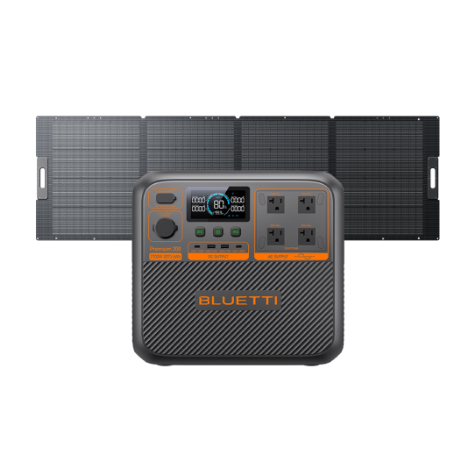
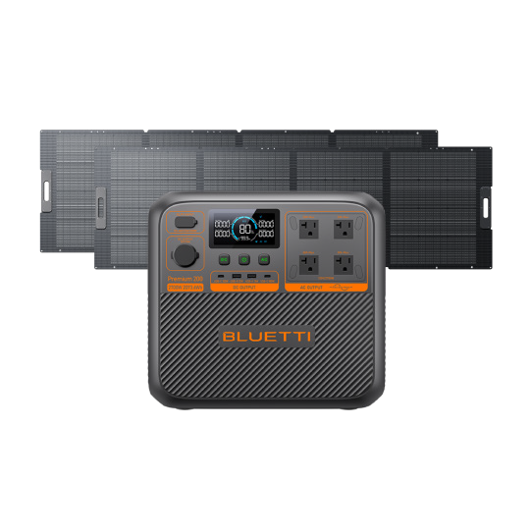
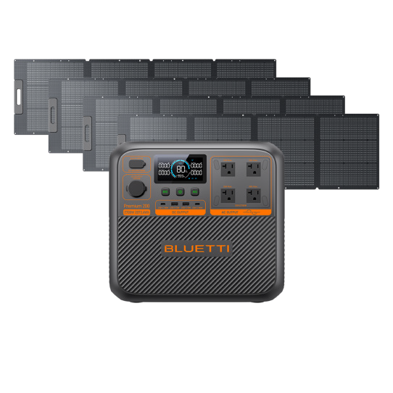
Choose Your Solutions
1
Solar Package
2
Solar Package
3
Solar Package
Premium 200 V2
350W BLUETTI FOLDABLE SOLAR PANEL
Premium 200 V2
2 x 350W BLUETTI FOLDABLE SOLAR PANEL
(Total 700W Solar Input Connect In Parallel)
Premium 200 V2
4 x 200W BLUETTI FOLDABLE SOLAR PANEL
(Total 800W Solar Input Connect In Parallel)

